Slide 1

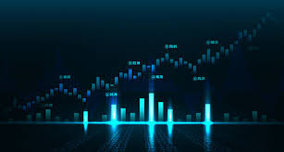
A Winning Strategy “If you want to have a better performance than the crowd, you must do things differently from the crowd” - Sir Johnson Templeton
Jeremy Radcliffe, Levi Christian, Bill Udeh

Slide 2
Stock Trading Algo Overview
Utilizing industry standard leading and lagging indicators as feature inputs to our model, we sought to assess their impact on returns.
Our system evaluated 6mos of historical data consisting of daily close prices of a top stock from each industry.
Allocating an initial investment of $10,000 over a 6-month holding period, our model endeavored to predict next days price and produce positive returns?

Slide 3
Trading Model Summary
Model Check
Neural Network model utilizing stocks and four (4) features: Bollinger Bands, MACD, RSI and EMA benchmarked against the S&P500.
Target
Utilized Positive Returns as the Target to determine the success of our model. Long positions represented as “1”, Short positions represented as “-1” and “0” represented as neutral
Results
While the model accuracy score is low, results from cumulative returns were favorable

Slide 4
Historical Precedence

Slide 5
Core Questions
Can we iteratively improve the model accuracy by analyzing additional Time Series data and/or utilizing NLP to include additional features based on fundamental analysis?
TBD

Slide 6
Data Sources and Python Packages
Alpaca sourced Daily Close Price Data for:
S&P500
FB
Python Packages:
Pathlib
Pandas
Numpy
Joblib
Tensor Flow

Slide 7
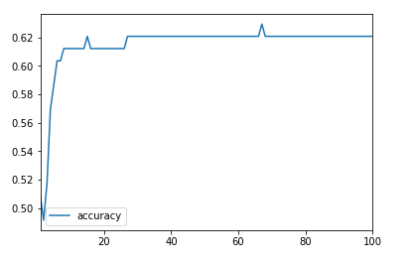

Data Analysis
TBD
TBD

Slide 11
Observations
We discovered that although the accuracy score was slightly above 50%, the overall performance over the targeted time period out-performed our SP&500 benchmark by more than 5% in most cases and as much as 20% in other cases.
Absent analysis of individual features made it difficult to determine which had the highest impact on returns thus a classification report would need to be produced in order to perform this level of analysis.
While the model performs well over a 6mo period, testing over longer periods produced…….

Slide 12
Postmortem
TBD.

Slide 13

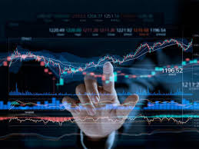
Questions?

